Slide 1
Strategy and the Internet
Information Technology Management

Slide 2

Defining the Business Problem
“The key question is not whether to deploy Internet technology – companies have no choice if they want to stay competitive – but how to deploy it.”
Michael Porter
  “Strategy and the Internet”
  Harvard Business Review
  March 2001
Notes:
Article is available on-line at http://www.hbsp.harvard.edu/
“E-business is no longer a buzz word … . It is driving every enterprise to overhaul entire business processes linked to a common infrastructure. As such, e-business is forcing the need to collect, dispense, and share information with any number of constituents in a free flowing manner in real time. “
SG Cowen September ’01
We must move from closed loop, silo-based infrastructure designed mainly for internal use must give way to infrastructure that enables the power of the Internet.
A collaborative environment involves users getting access to data, to other users. Issues are:
Security
Speed
Availability (7x24)

Slide 3
Porter's Forces Driving Industry Competition

Slide 4
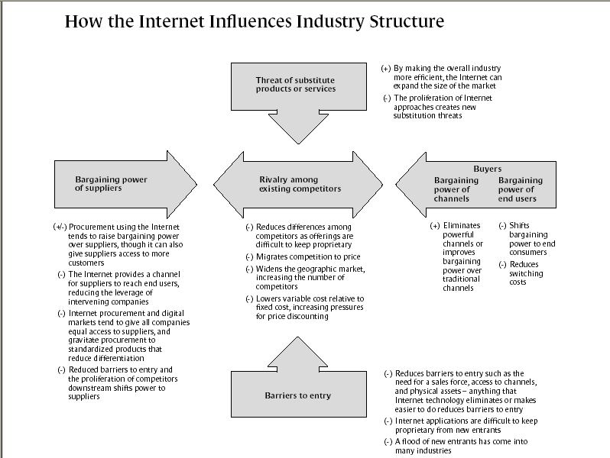
Porter, M.E. Porter (2001)

Slide 5
Creating value through e-business
  Why use of Internet technologies is more important to achieving competitive advantage than the technologies themselves.
  How Internet technologies are affecting the five competitive forces.

Slide 6
Creating value through e-business
  How e-business capabilities are affecting industry profitability
  How firms are using Internet technologies to add value and achieve unique advantages.
  How Interne-enabled business models are being used to improve strategic positioning.
  How firms can improve their competitive position by effectively deploying e-business strategies.

Slide 7
Number of U.S. Citizens Online
Number of U.S. Citizens Online
150
66% of population
125
100
Millions
75
50
25
9% of population
0
1995
1996
1997
1998
1999
2000
2001
2002
Adapted from Exhibit 8.1 Growth in Internet Activity

Slide 8
Internet Use Worldwide
Internet Users (in millions)
2007
Geographic Region 2002 (estimated)
North America 178,530 254,350
Western Europe 151,999 290,999
Eastern Europe/Russia 34,155 98,151
Asia-Pacific 237,922 615,571
South/Central America 39,146 110,893
Middle East/Africa 23,922 96,287
Total Internet Users 665,674 1,466,251
Adapted from Exhibit 8.1 Growth in Internet Activity

Slide 9
How the Internet is Affecting the Five Competitive Forces
Threat of New Entrants
Internet technologies lower barriers to entry
Scale economies may be less important in Internet context
New entrants can go to market with lower capital costs
Businesses on the Internet may have lower expenses such as office rent, printing, and postage

Slide 10
How the Internet is Affecting the Five Competitive Forces
Bargaining Power of Buyers
End users
  Final customers in a distribution channel
  B2C Internet sales activity (business to consumer)
  Internet increases the power of these buyers
    more information
    Lower switching costs
  Such buyers likely to have more bargaining power

Slide 11
How the Internet is Affecting the Five Competitive Forces
Bargaining Power of Buyers
Buyer channel Intermediaries
  Wholesalers, distributors, and retailers
  Internet makes it easier for the business to reach consumers directly
  Internet may decrease the bargaining power of buyer channel intermediaries

Slide 12
How the Internet is Affecting the Five Competitive Forces
Bargaining Power of Suppliers
B2B—providing products or services to other businesses
Advantages
  Access to business customers at lower cost
  More downstream outlets
  Creation of Web-based purchasing arrangements
    Makes purchasing easier
    Discourages customers from switching
  Can reach end users without intermediaries

Slide 13
How the Internet is Affecting the Five Competitive Forces
Bargaining Power of Suppliers
Disadvantages
  Buyers can shop competitively and negotiate prices easier
  Inhibited ability to offer differentiated products or unique services
Creating new functions (reintermediation)

Slide 14
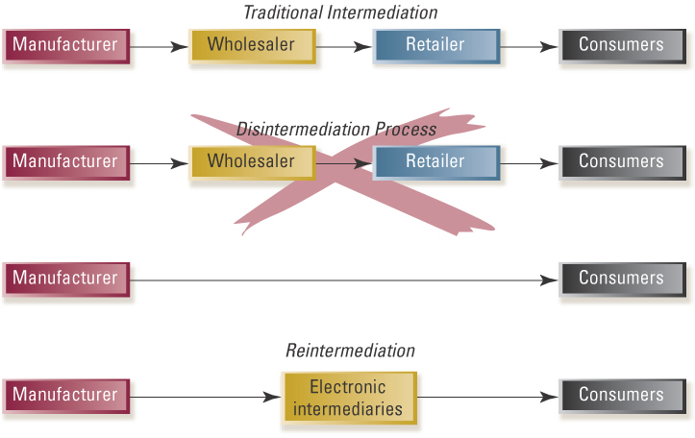
Disintermediation and Reintermediation
Adapted from Exhibit 8.2 Disintermediation and Reintermediation

Slide 15
How the Internet is Affecting the Five Competitive Forces
Threat of Substitutes
Threat of substitutes is increased because the Internet creates new ways to accomplish the same tasks
  Alternative way to participate in conferences
  Storing information on the Web
  Online market surveys
Primary factor increasing substitution is economic

Slide 16
How the Internet is Affecting the Five Competitive Forces
Intensity of Competitive Rivalry
Rivalry is likely to be more intense
  More tools and means for competing
  New firm technologies can be imitated easily and quickly
  Competitors in cyberspace are more equally balanced and competitive
  Informediaries increase importance of pricing

Slide 17

How the Internet Influences Industry Structure
Threat of new substitutes
  (+) by making an overall industry more efficient, the internet can expand sales in that industry
  (-) internet-based capabilities create new substitution threats
  (-) technology-based efficiencies can be captured, lowering the impact of scale economies
  (-) differences among competitors are difficult to detect and to keep proprietary
Adapted from Exhibit 8.3 How the Internet Influences Industry Structure
Source: Adapted from M. E. Porter, “Strategy and the Internet,” Harvard Business Review, March 2001, pp. 63-78.

Slide 18
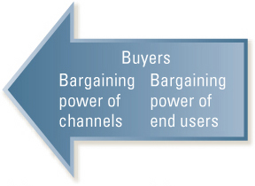
How the Internet Influences Industry Structure
Bargaining power of buyers
Bargaining power of channels
  (+) eliminates powerful channels or improves bargaining power over traditional channels
Bargaining power of end users
  (-) shifts bargaining power to consumers
  (-) reduces switching costs
Adapted from Exhibit 8.3 How the Internet Influences Industry Structure
Source: Adapted from M. E. Porter, “Strategy and the Internet,” Harvard Business Review, March 2001, pp. 63-78.

Slide 19
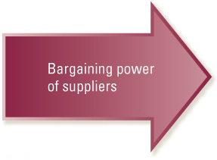
How the Internet Influences Industry Structure
Bargaining power of suppliers
  (+-) procurement using the Internet may raise bargaining power over suppliers, but it can also give suppliers access to more customers
  (-) the Internet provides a channel for suppliers to reach end users, reducing the power of intermediaries
  (-) Internet procurement and digital markets tend to reduce differentiating features
  (-) reduced barriers to entry and the proliferation of competitors downstream shifts power to suppliers
Adapted from Exhibit 8.3 How the Internet Influences Industry Structure
Source: Adapted from M. E. Porter, “Strategy and the Internet,” Harvard Business Review, March 2001, pp. 63-78.

Slide 20

How the Internet Influences Industry Structure
Threat of new entrants
  (-) reduces barriers to entry such as need for a sales force, access to channels, and physical assets
  (-) Internet applications are difficult to keep proprietary from new entrants
  (-) a flood of new entrants has come into may industries
Adapted from Exhibit 8.3 How the Internet Influences Industry Structure
Source: Adapted from M. E. Porter, “Strategy and the Internet,” Harvard Business Review, March 2001, pp. 63-78.

Slide 21
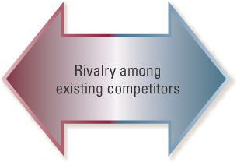
How the Internet Influences Industry Structure
Rivalry among existing competitors
  (-) more priced-based competition intensifies rivalry
  (-) widens the geographic market, increasing the number of competitors
Adapted from Exhibit 8.3 How the Internet Influences Industry Structure
Source: Adapted from M. E. Porter, “Strategy and the Internet,” Harvard Business Review, March 2001, pp. 63-78.

Slide 22
How the Internet Adds Value
Product-related
Evaluation
Search
Transaction
Service-related
Problem Solving
Exhibit 8.4 Internet Activities That Add Value
Sources: Adapted from M. Zeng and W. Reinartz, “Beyond Online Search: The Road to Profitability, “ California Management Review, Winter 2003, pp. 107-30; and C. B. Stabell and O. D. Fjeldstad, “Configuring Value for Competitive Advantage; On Chains, Shops, and Networks,” Strategic Management Journal 19 (1998), pp. 413-37.

Slide 23
How the Internet Adds Value
The process of gathering information and identifying purchase options
  Faster speed of information gathering (buyers, suppliers)
  Greater breadth of information that can be accessed (buyers)
  Decreased cost of search (buyers)
  Easier to be found (suppliers)
Search

Slide 24
How the Internet Adds Value
Search
The process of considering alternatives and comparing the costs and benefits of various options
  Facilitates comparative shopping (buyers)
  Provides product reviews (buyers)
  Catalogues customer evaluations of performance (buyers, suppliers)
Evaluation

Slide 25
How the Internet Adds Value
Search
The process of identifying problems or needs and generating ideas and action plans to address those needs
  Ability to handle unique problems individually (buyers, suppliers)
  Ability to provide immediate answers (buyers, suppliers
  Ability to deliver new products and services (suppliers)
Evaluation
Problem Solving

Slide 26
How the Internet Adds Value
Search
The process of completing the sale, including negotiating and agreeing contractually, making payments, and taking delivery
  Lowering overall transaction cost (buyers, suppliers)
  Permitting more rapid sales (buyers, suppliers)
  More reliable transactions
Evaluation
Problem Solving
Transaction

Slide 27
How the Internet Adds Value
Internet content as a source of competitive advantage
  Customer feedback
    Buyers trust what other buyers say more than a company’s promises
    Customer testimonials
  Expertise
    Internet as a library
    Education of consumers regarding options and implications of various choices
  Entertainment programming
    Streaming media
    Interactive programming and other applications

Slide 28
Internet Business Models
Features and content
  Commissions charged
  Brokerage or intermediary services
  Adds value by providing
    Expertise
    access to a wide network of alternatives
Sources of competitive advantage
  Search
  Evaluation
  Problem solving
  Transaction
Commission-based models

Slide 29
Internet Business Models
Features and content
  Web content paid for by advertisers
  Adds value by providing free or low-cost content
    Customer feedback
    Expertise
    Entertainment
  Audiences range from very broad to highly specialized
Sources of competitive advantage
  Search
  evaluation
Advertising-based models

Slide 30
Internet Business Models
Features and content
  Reselling marked-up merchandise
  Adds value through
    Selection
    Distribution efficiencies
    Leveraging brand image and reputation
  May use entertainment programming to enhance sales
Sources of competitive advantage
  Search
  Transaction
Markup-based models

Slide 31
Internet Business Models
Features and content
  Selling manufactured goods and custom services
  Adds value by
    Increasing production efficiencies
    Capturing customer preferences
    Improving customer service
Sources of competitive advantage
  Search
  Problem solving
Production-based models

Slide 32
Internet Business Models
Features and content
  Fees charged for referring customers
  Adds value by
    Enhancing a firm’s product or service offerings
    Tracking referrals electronically
    Generating demographic data
  Expertise and customer feedback often included with referral information
Sources of competitive advantage
  Search
  Problem solving
  Transaction
Referral-based models

Slide 33
Internet Business Models
Features and content
  Fees charged for unlimited use of service or content
  Adds value by
    Leveraging strong brand name
    Providing high quality information to specialized markets
    Providing access to essential services
  May consist entirely of entertainment programming
Sources of competitive advantage
  Evaluation
  Problem solving
Subscription-based models

Slide 34
Internet Business Models
Features and content
  Fees charged for metered services
  Adds value by providing
    Service efficiencies
    Expertise
    Practical outsourcing solutions
Sources of competitive advantage
  Problem solving
  Transaction
Fee-for-service-based models

Slide 35
Overall Cost Leadership Strategy and the Internet
Internet can decrease costs throughout a firm’s value chain in both primary and support activities
  Minimizing rework
    Direct access to progress reports
    Ability for customers to periodically check work in progress
  Minimizing sales-force expenses
    Online bidding
    Online order processing
  Reducing costs of procurement and paper
    Online purchase orders makes many transactions paperless

Slide 36
Overall Cost Leadership Strategy and the Internet
Internet can decrease costs throughout a firm’s value chain in both primary and support activities
  Reducing costs and speeding the process of new-product development
    Collaborative design efforts (internet links designers, materials suppliers, and manufacturers)
  Reducing costs of hiring and training employees
    Online testing
    Online evaluation
    Online training

Slide 37
Differentiation Strategy and the Internet
Internet can create new ways of differentiating by enabling mass customization and increasing customer control over the process
  Shortening response times and accelerating organization learning
    Internet-based knowledge management systems
    Linking all parts of the organization
  Personalizing online access so customers can access
    Prior orders
    Current order status
    Process requests for future orders

Slide 38
Differentiation Strategy and the Internet
Internet can create new ways of differentiating by enabling mass customization and increasing customer control over the process
  Enhancing marketing efforts
    Quick online response to service requests
    Rapid feedback to customer surveys and product promotions
  Empowered sales force and updated R&D efforts
    Online access to real-time sales and service information
  Access to detailed status reports and purchasing histories
    Automated procurement and payment systems

Slide 39
Focus Strategy and the Internet
Internet permits focusers to access markets less expensively (low cost) and provides more services and features (differentiation)
  Focusing sales efforts on specific customers
    Permission marketing techniques
  Creating community for customers with common interests
    Chat rooms
    Discussion boards
    Member functions

Slide 40
Focus Strategy and the Internet
Internet permits focusers to access markets less expensively (low cost) and provides more services and features (differentiation)
  Providing advertisers with access to viewers with specialized interests
    Niche portals
  Minimizing firm infrastructure requirements
    Virtual organizing
    Online “officing”
  Highlighting specialized buyers and drawing attention to smaller suppliers
    Procurement technologies (matching buyers and sellers)

Slide 41
Potential Internet-Related Pitfalls
Low-cost leaders
  Ease of imitation by competitors
  Ease of comparison shopping by consumers
  Temptation to place too much emphasis on one business activity and ignore others
Differentiators
  Sustainability of internet gains may deteriorate if differentiating features are unwanted by customers
  Overpriced products and services
Focus
  Misreading scope and interests of target markets

Slide 42
Leveraging Internet Capabilities
Providing new ways to add value
Shifting power of the five forces
Requiring modifications in generic strategies
Altering competitive climate in many industries
Business-Level strategy

Slide 43
Leveraging Internet Capabilities
New means of generating synergies
Enhancing revenue among elements of a diverse firm
Linking sources of supply more efficiently
Streamlining distribution
Dealing with suppliers more efficiently
Business-Level strategy
Corporate-Level strategy

Slide 44
Leveraging Internet Capabilities
Conducting business without time and expense of physical travel
Increasing level of access to local cultures and market conditions
Addressing both cost reduction and local adaptation issues
Facilitating collaboration between remote locations
Business-Level strategy
Corporate-Level strategy
International-Level strategy

